Slide 1

PROJECT
PROPOSAL
DiabAnalytica: Predictive Modeling for Type 2 Diabetes
TEAM - LMX

Slide 2
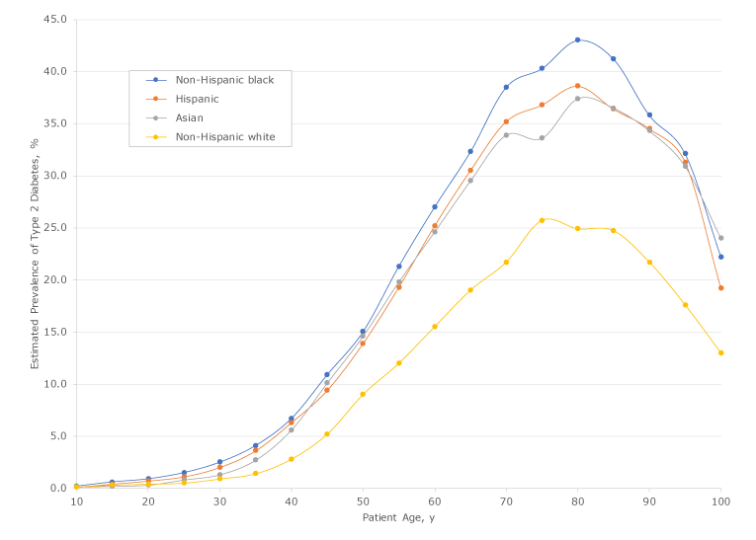
Problem Details - 1
Rising global impact of Type 2 Diabetes Mellitus (T2DM) on health
Urgent need to develop a mortality prediction model for elderly Type 2 Diabetes Mellitus (T2DM) patients for:
proactive intervention
personalized treatments
addressing current gaps
Accurate Predictions
Proper Diabetic Treatment Plans
Identify High Risk Individuals
Mitigating Mortality in Older Patients

Slide 3
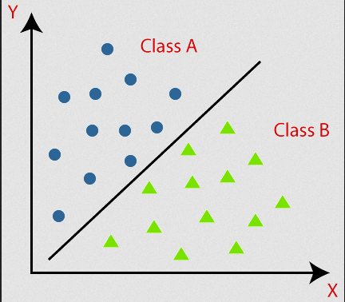
Problem Details - 2
Objective
To identify important clinical biomarkers
To high-risk individuals
To identify comorbidities causing death
Scope
Focus on U.S. military veterans aged 65+ with T2DM
Milestones
Data Collection & Preparation
Model Development & Comparison
Evaluation

Slide 4
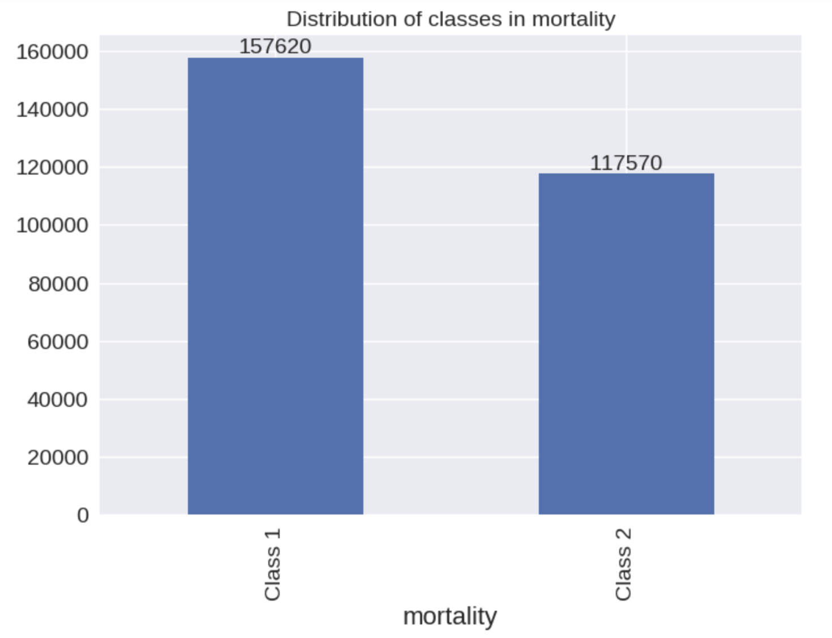
Dataset Details
Dataset
#Instances
#Predictors
Target Variable
Mortality
(DEATH_5 and DEATH_10)
Veterans Health Administration and Medicare, covering 2004-2016
275,190
68
Demographics | Clinical Factors | Comorbidities | Target Variable
Age, Gender, Race | BMI, Diastolic, Systolic, HDL, LDL | Alcohol abuse, AIDS/HIV, Depression, Hypertension | Class 1, Class 2
Data Preparation
Modifying target variable
Handle missing values
Remove duplicate instances
Handle outliers by using binning
Handling imbalance of classes in predictors
Feature engineering
* Class 1 indicates remaining life is up to 10 years and Class 2 indicates remaining life more than 10 years

Slide 5

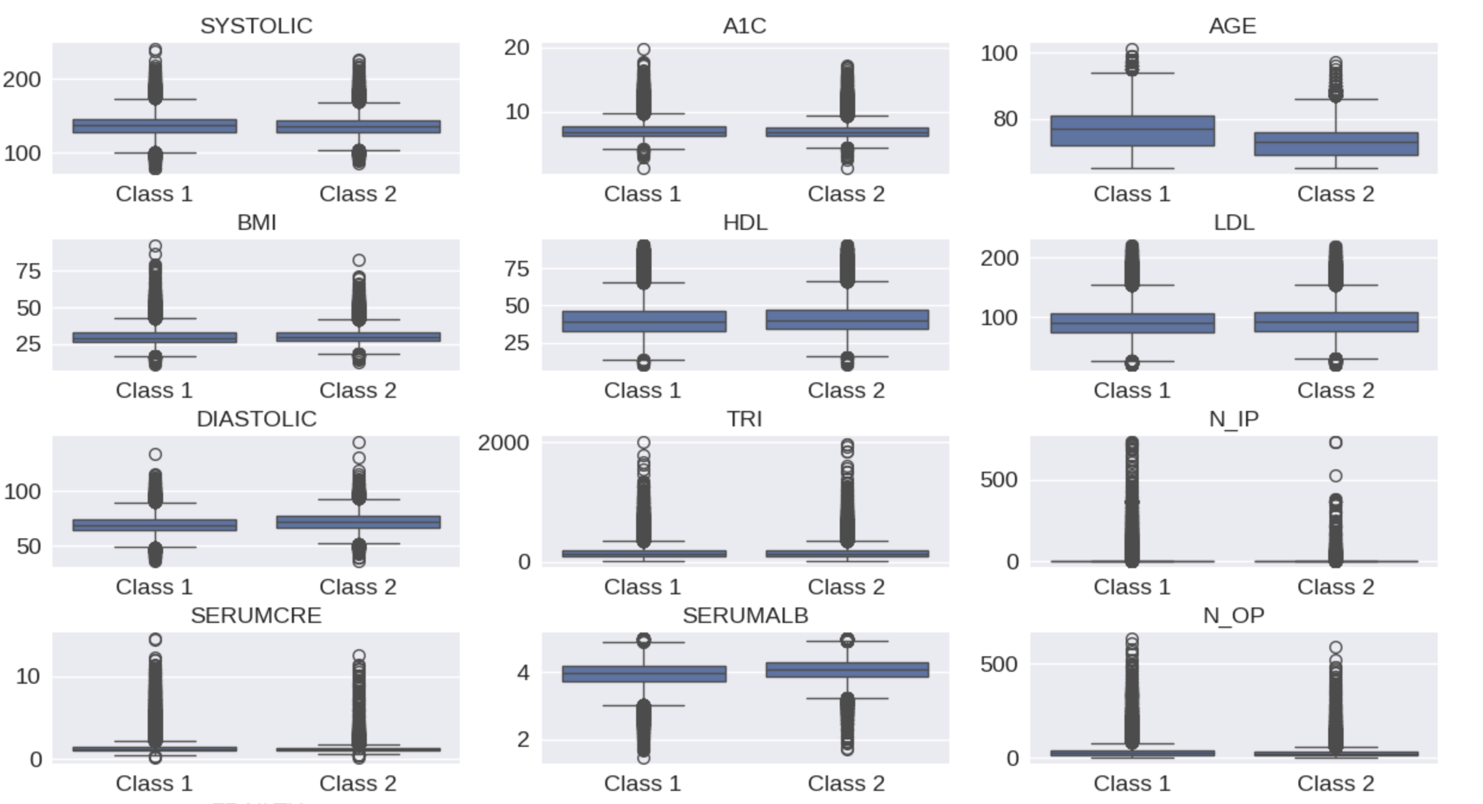
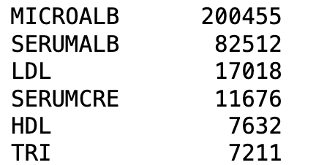
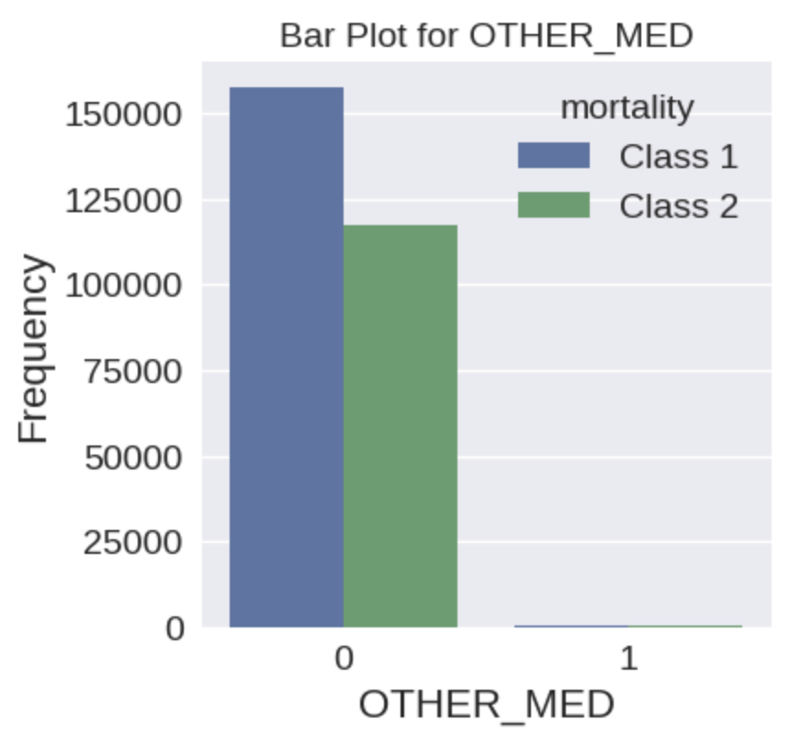
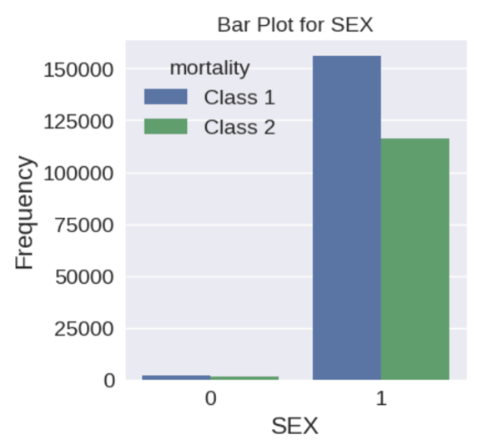
Dataset Insights
Missing Values
#Duplicates
4650
Chi-Sq
”Sex” – p value > significance level
Phi Coeff
Some association identified b/w variables
Information Value & Weight of Evidence
Weak, moderate & strong predictors identified
Mutual Information
20 best predictors selected

Slide 6
Modelling
Baseline Model – Majority Classifier
Candidate Model
Reference point for evaluation
Imbalance classes in target variable
Simple & computationally inexpensive
Model | Reason
Logistic Regression | Binary target variable, higher interpretability
Random Forest | Robust to noise & outliers, high predictive accuracy
XGBoost | Capture complex interactions
Decision Trees | Capture non-linear relationship, better interpretability
Training & Testing Validation
Evaluation Metrics
Train Set - ?
Test Set - ?
Sampling – Stratified
Confusion Matrix
Akaike Information Criterion
Area Under Curve Score
Kappa

Slide 7
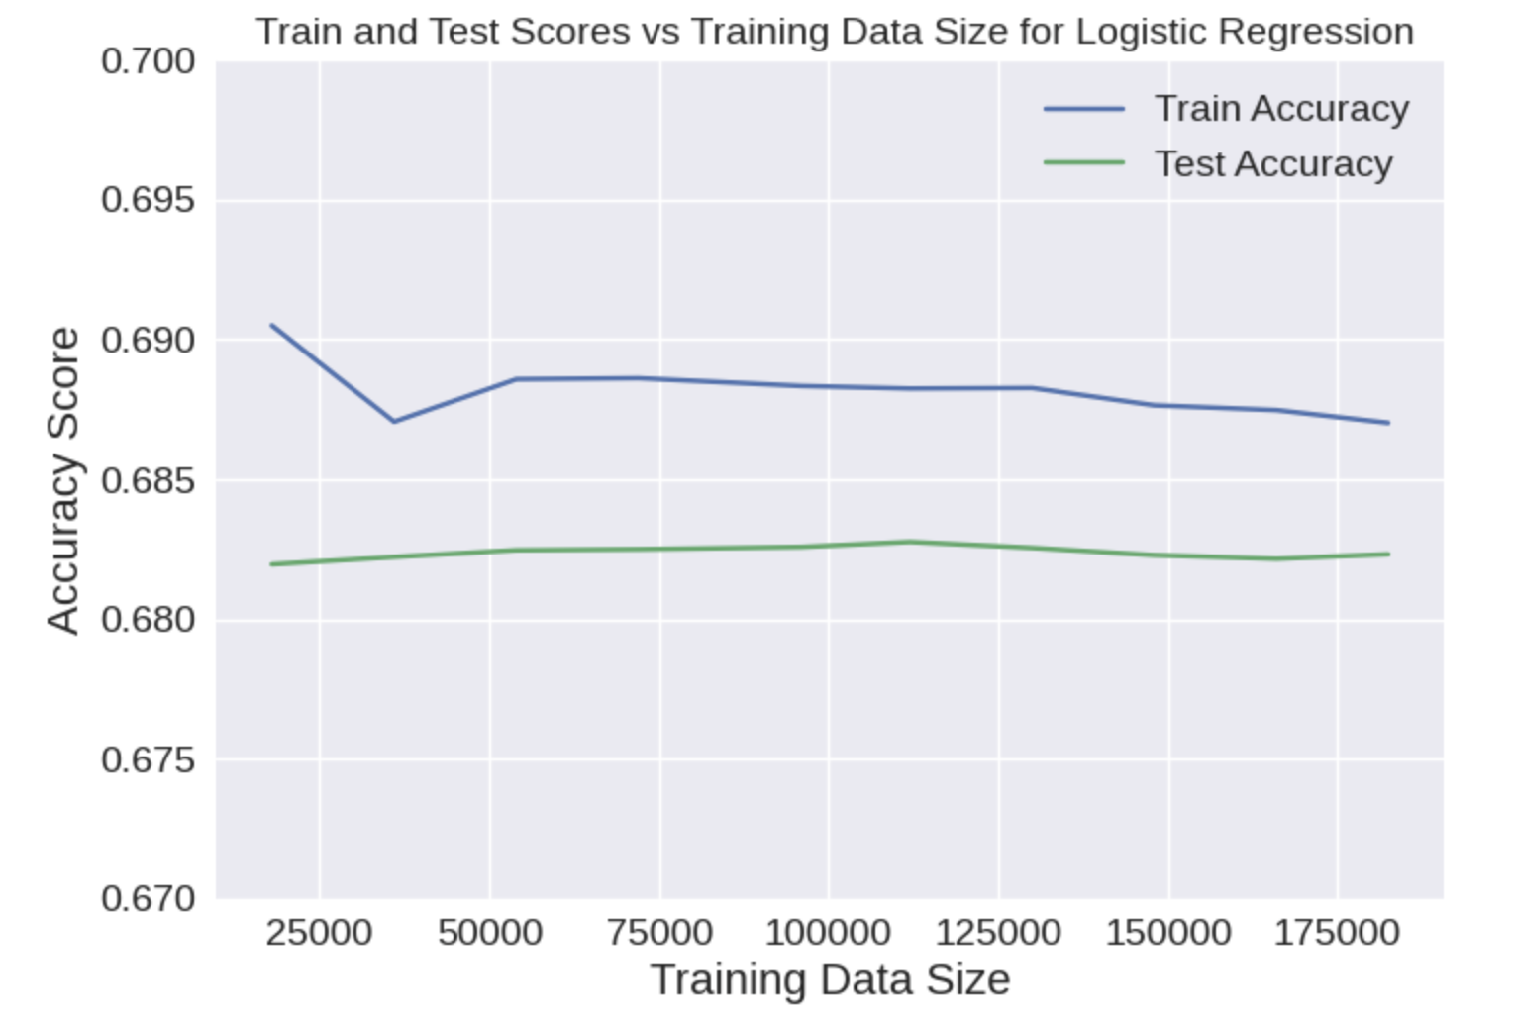
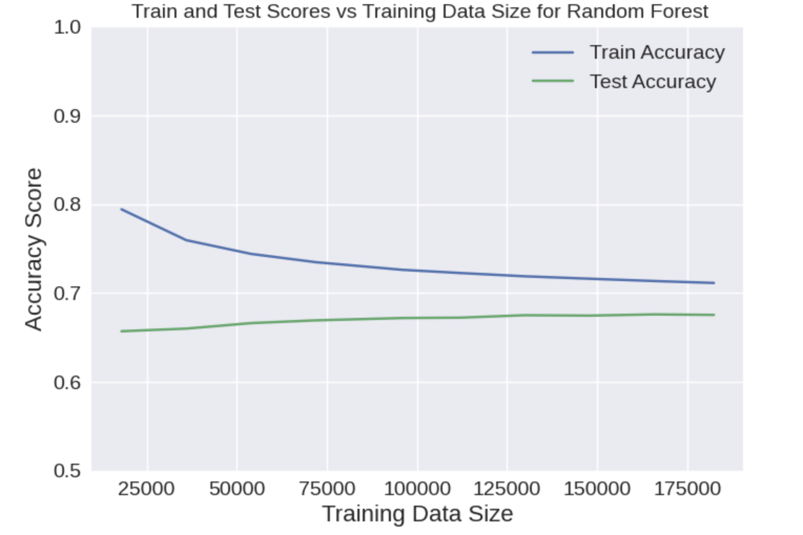
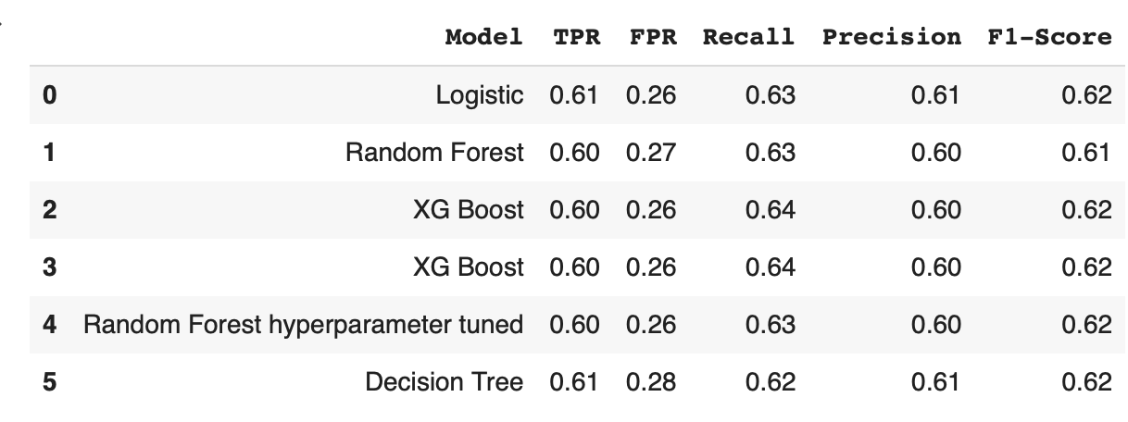
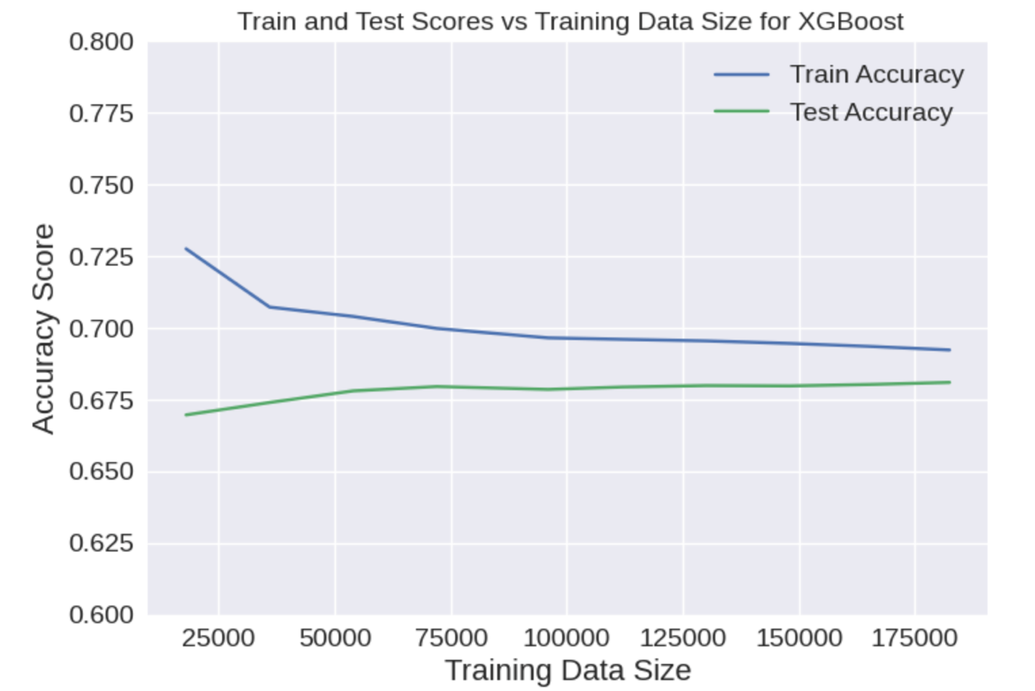
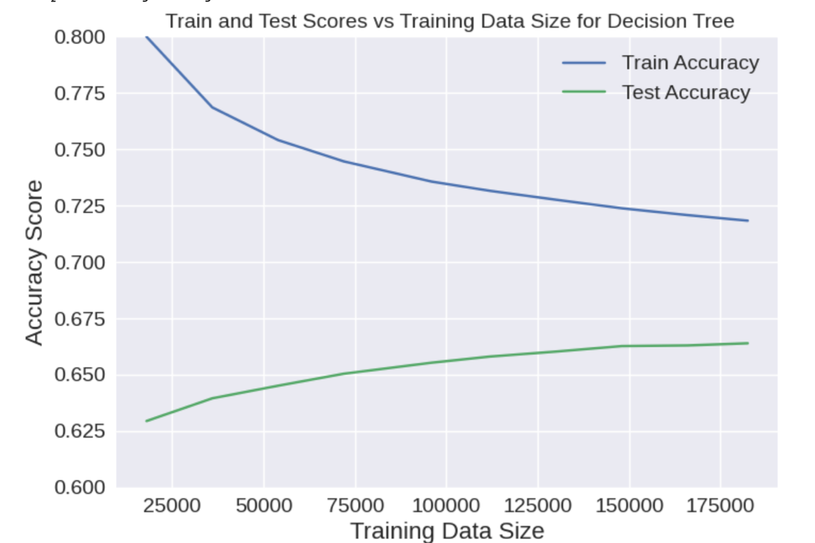
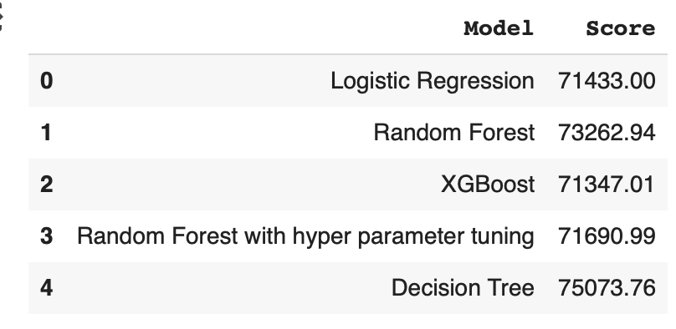
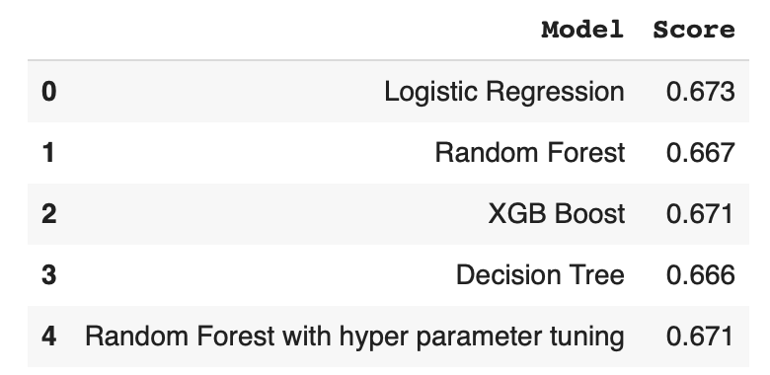
Results
Model Performance
Model Comparison
AIC Score
AUC Score
Model | Accuracy | Model Fit Time
Baseline Majority Classifier | 57% | Very Less
Logistic Regression | 68% | Less
Random Forest | 67% | High
XGBoost | 68% | Moderate
Random Forest Tuned | 68% | High
Decision Tree | 67% | Moderate
KAPPA Score
Logistic Regression x XGBoost– 96%
Random Forest Hyper Parameter Tuned x Logistic Regression – 92%
Random Forest x XGBoost – 92%
All combinations > 79%

Slide 8
Key Findings
Results
Implications
Limitation
Major causes are heart-related illnesses
Vulnerable “80–84” age group
Require vigilant cardiac evaluation and serum creatinine monitoring
Model accuracy is 68% (not good)
Results are not reliable for industry use
Involve domain experts for additional factors (medical reasons)
Limited population representation
Potential residual biases
Exploration on feature and model selection
8
* Heart related illness - peripheral vascular diseases, congestive heart failure, cardiac arrhythmias

Slide 9
Conclusion
Identified critical predictors like age and cardiovascular diseases
Logistic Regression and XGBoost performed slightly better in terms of confusion matrix
Logistic Regression favored due to its interpretability and faster processing time
Exploration of alternative model & feature selection techniques to enhance reliability of the results

Slide 10

Thank
You

Slide 11
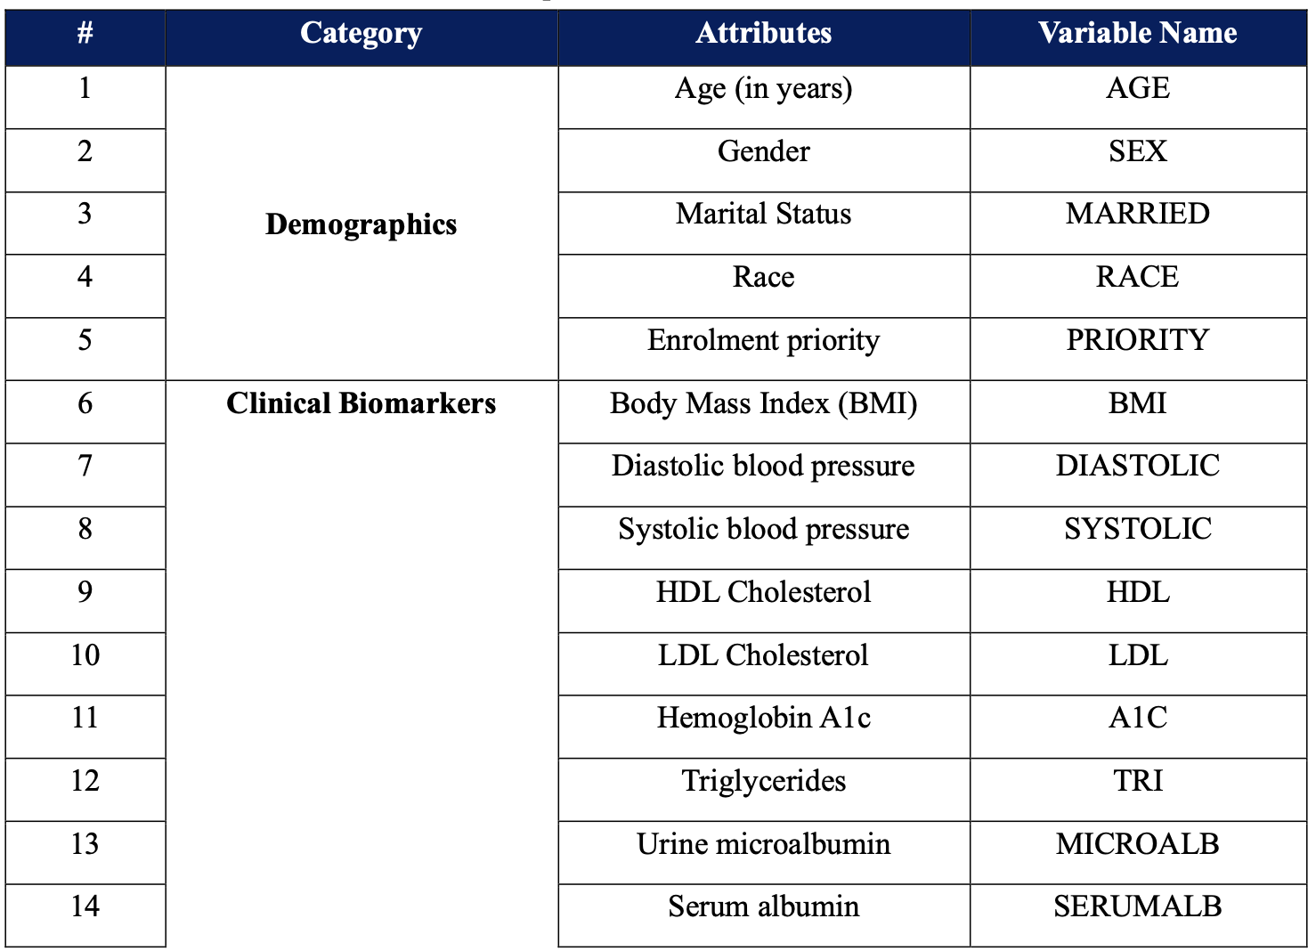
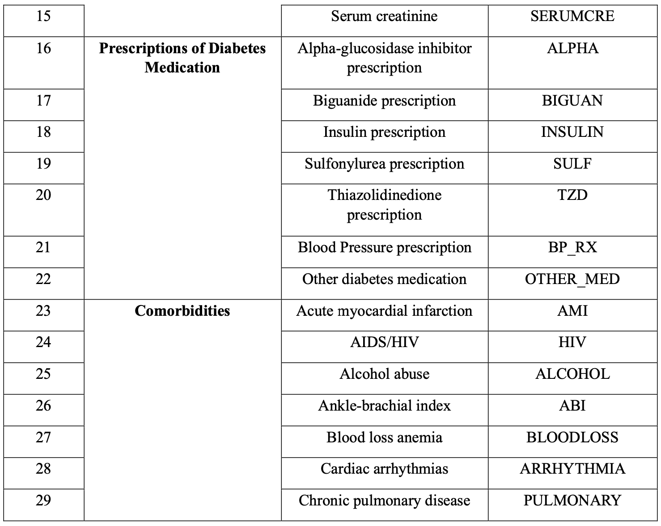
Appendix

Slide 12
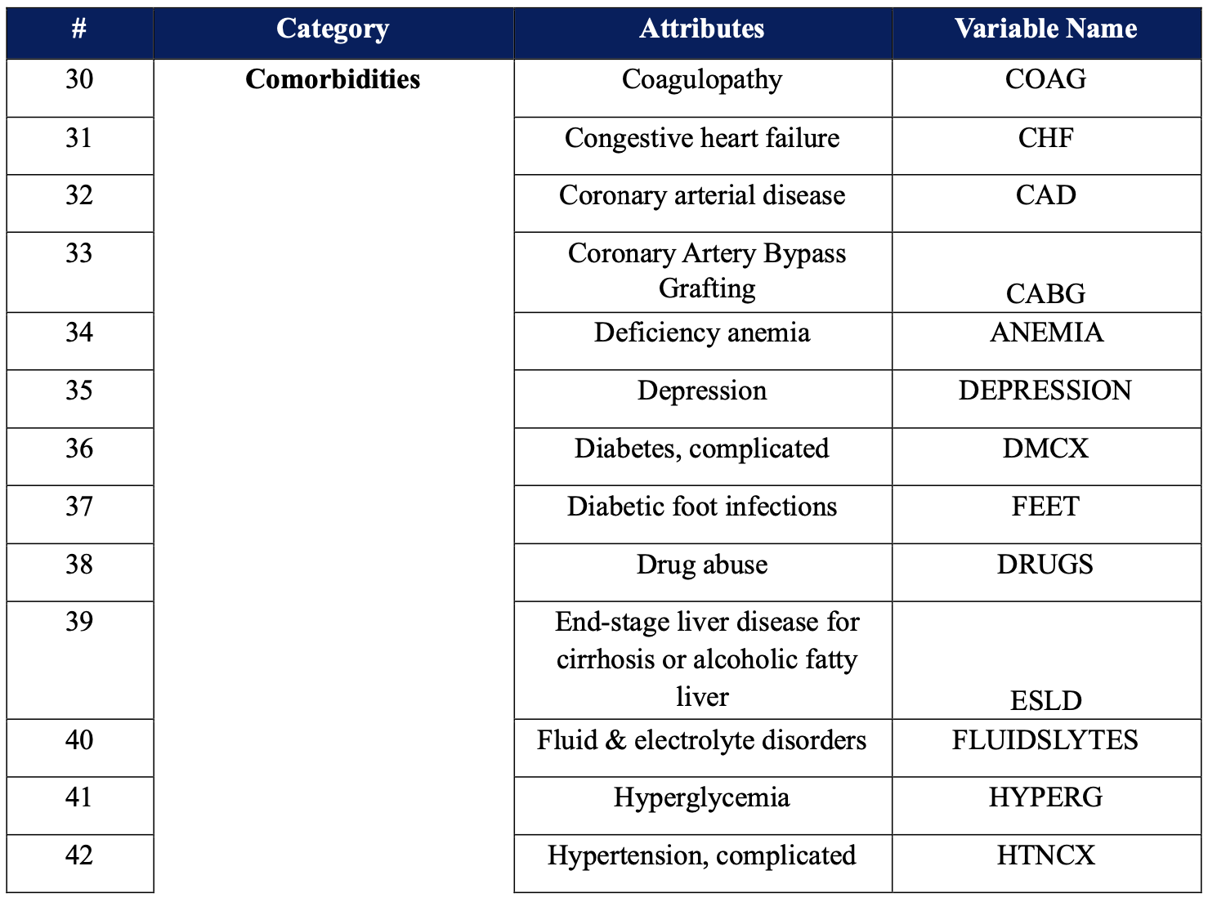
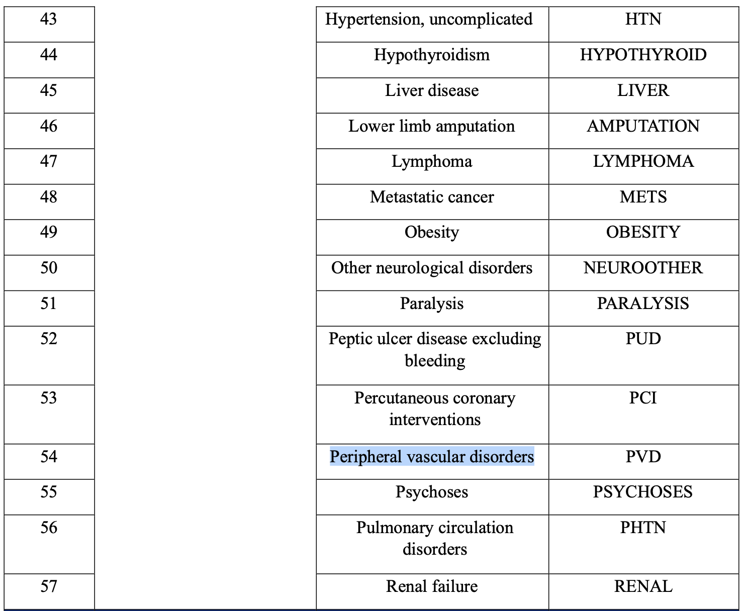

Slide 13
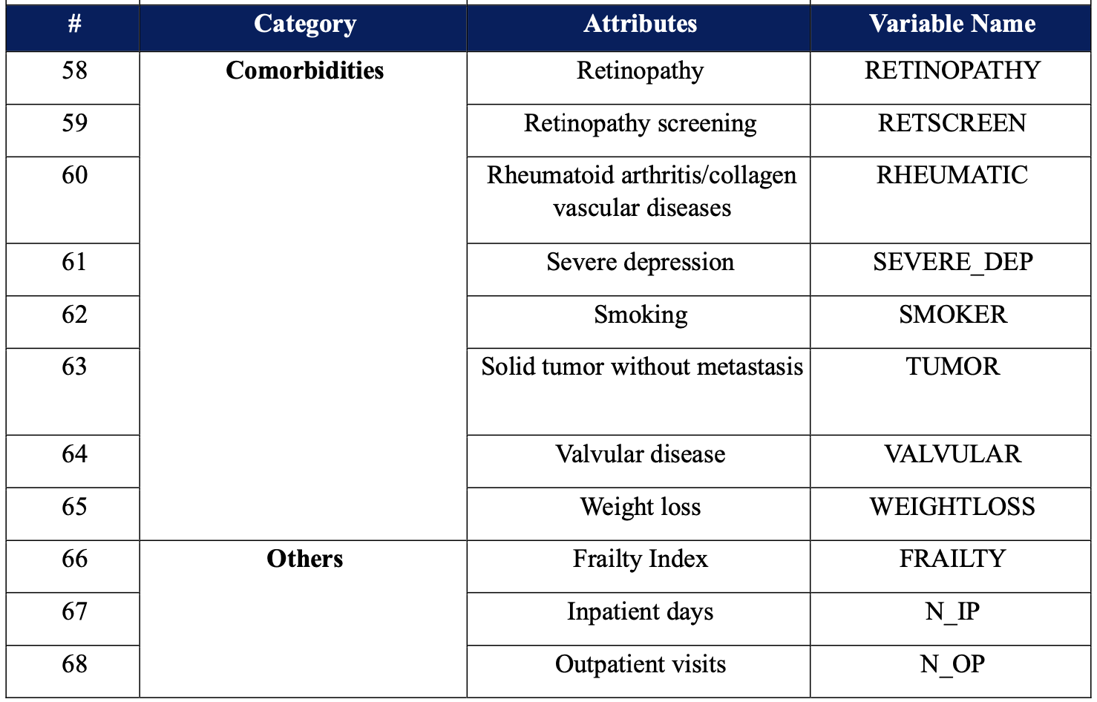

Slide 14
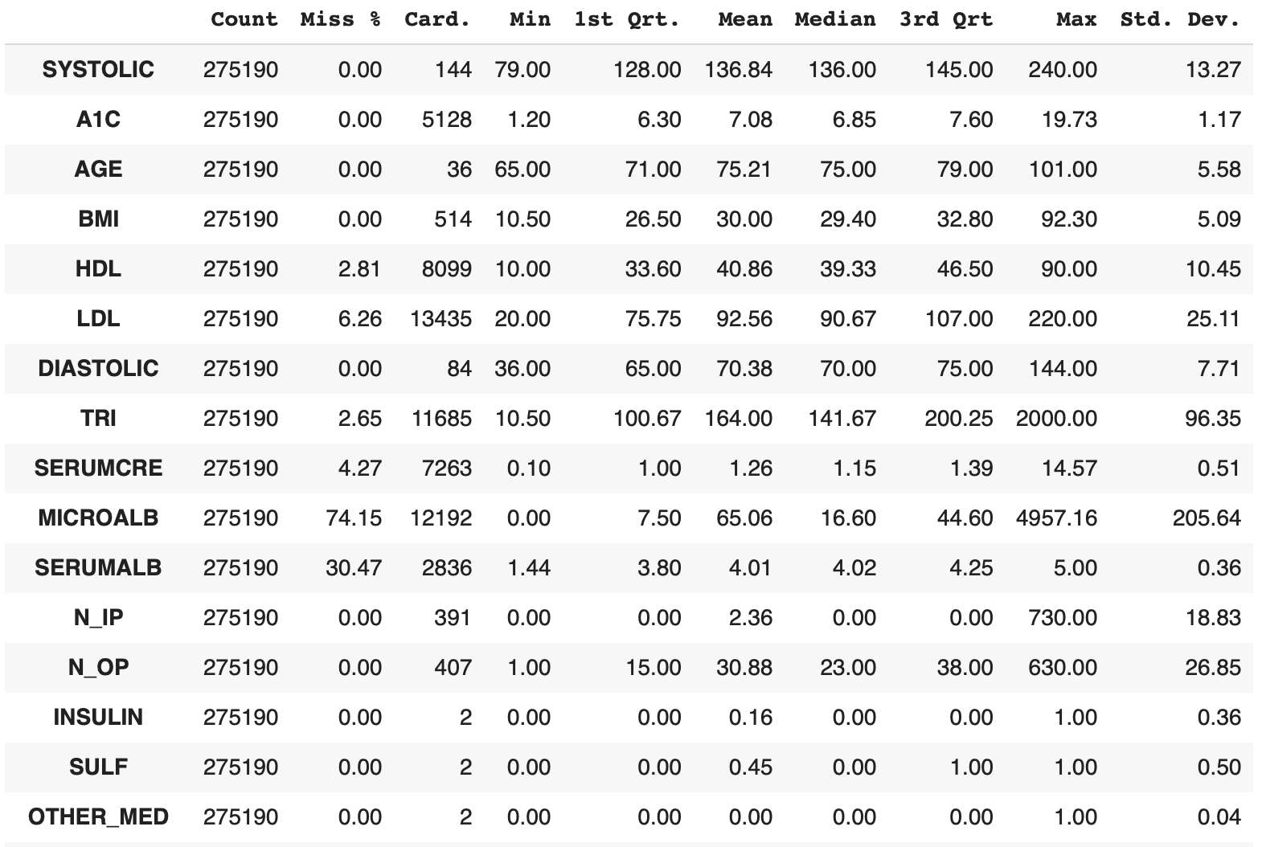
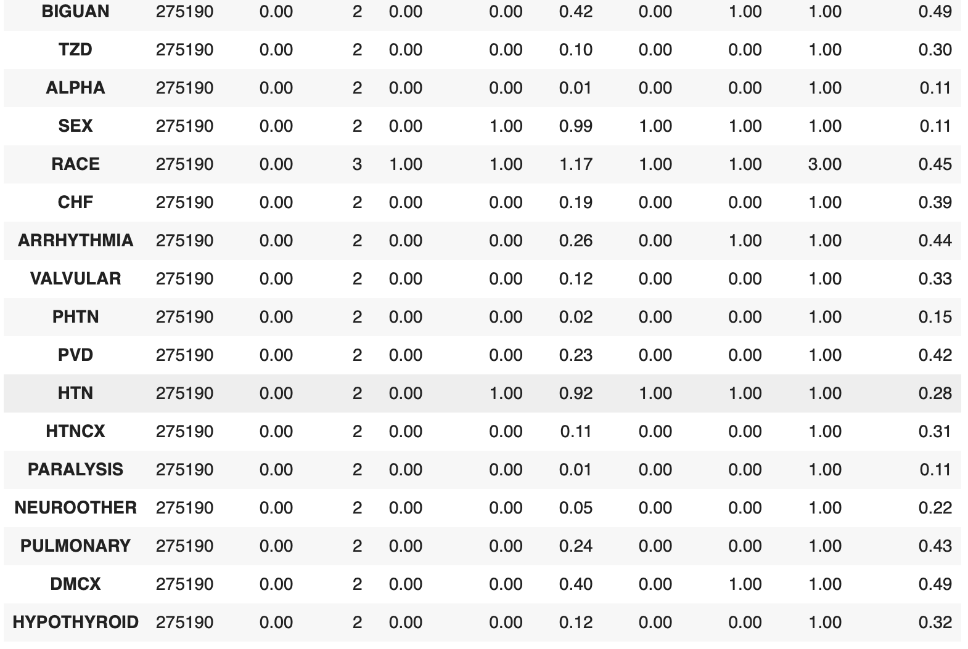
ABT Report

Slide 15
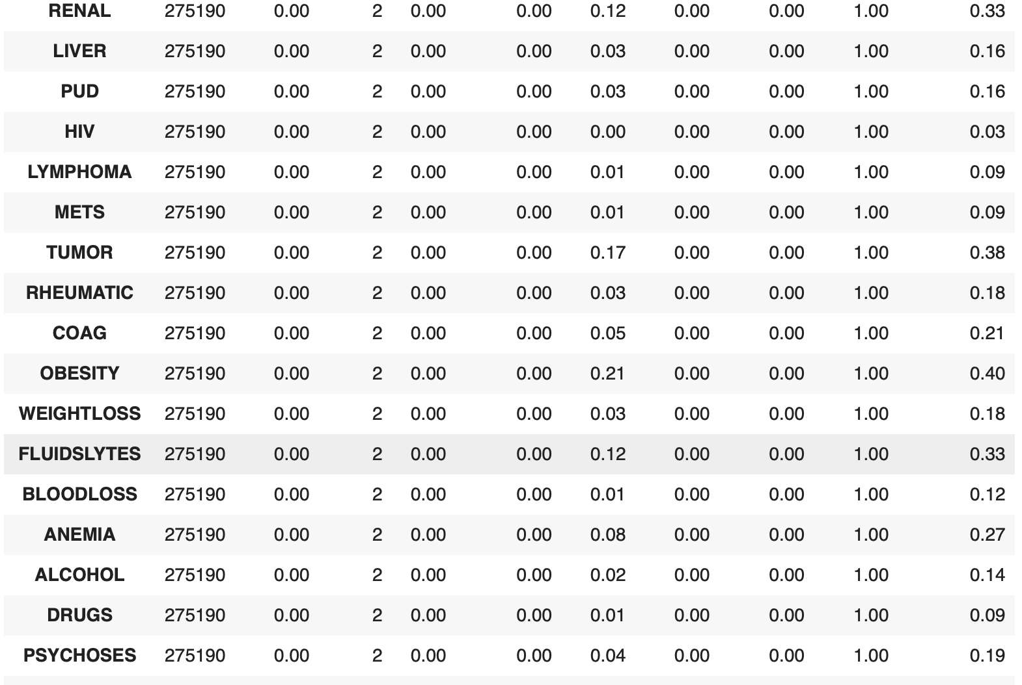
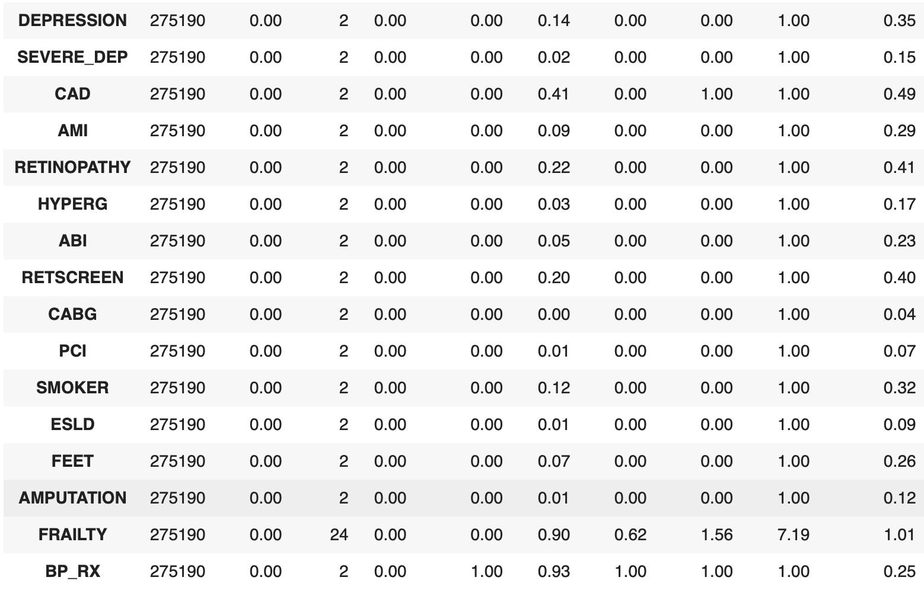
ABT Report

Slide 16
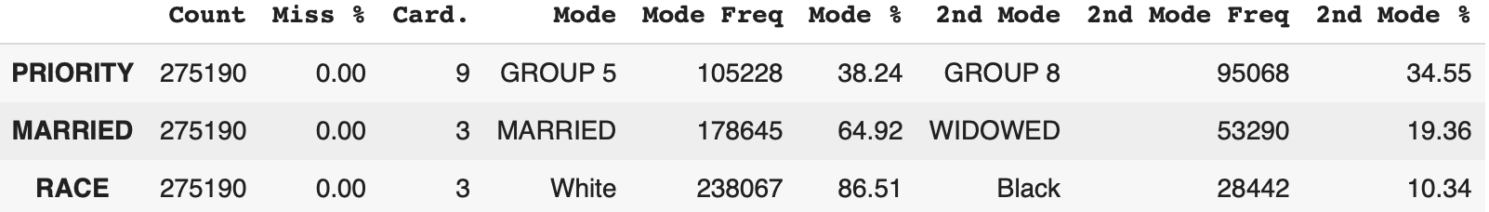
ABT Report

Slide 17
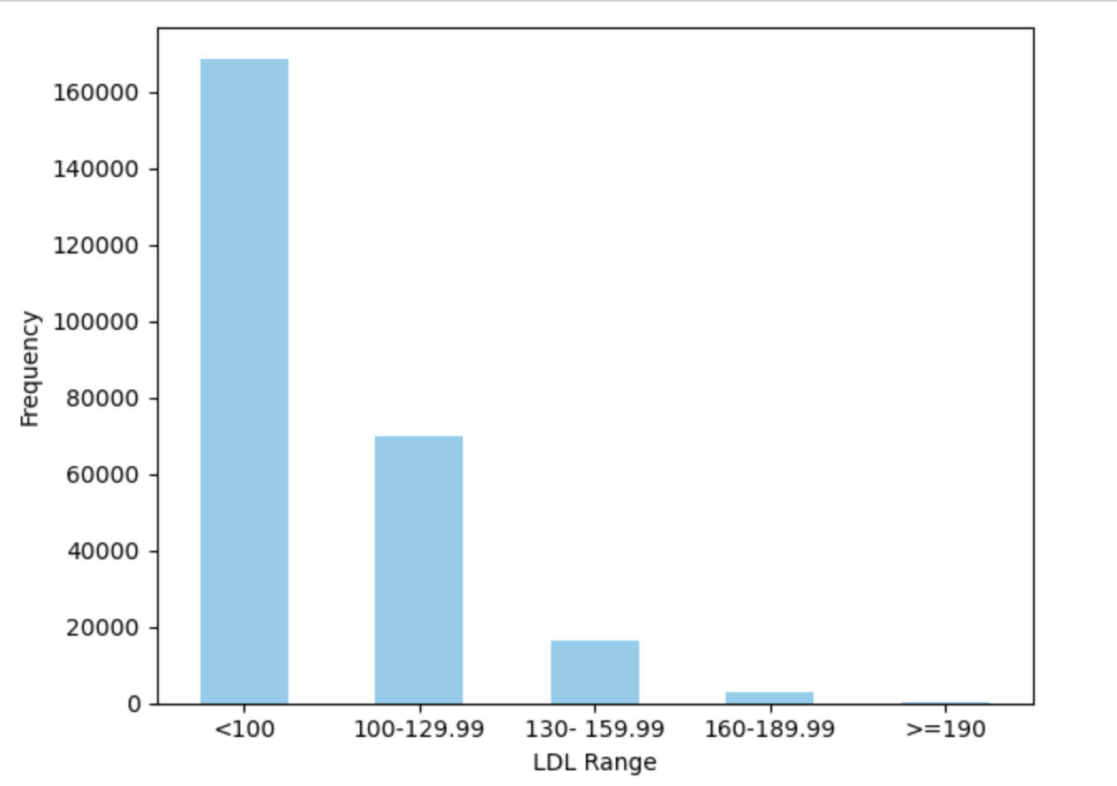
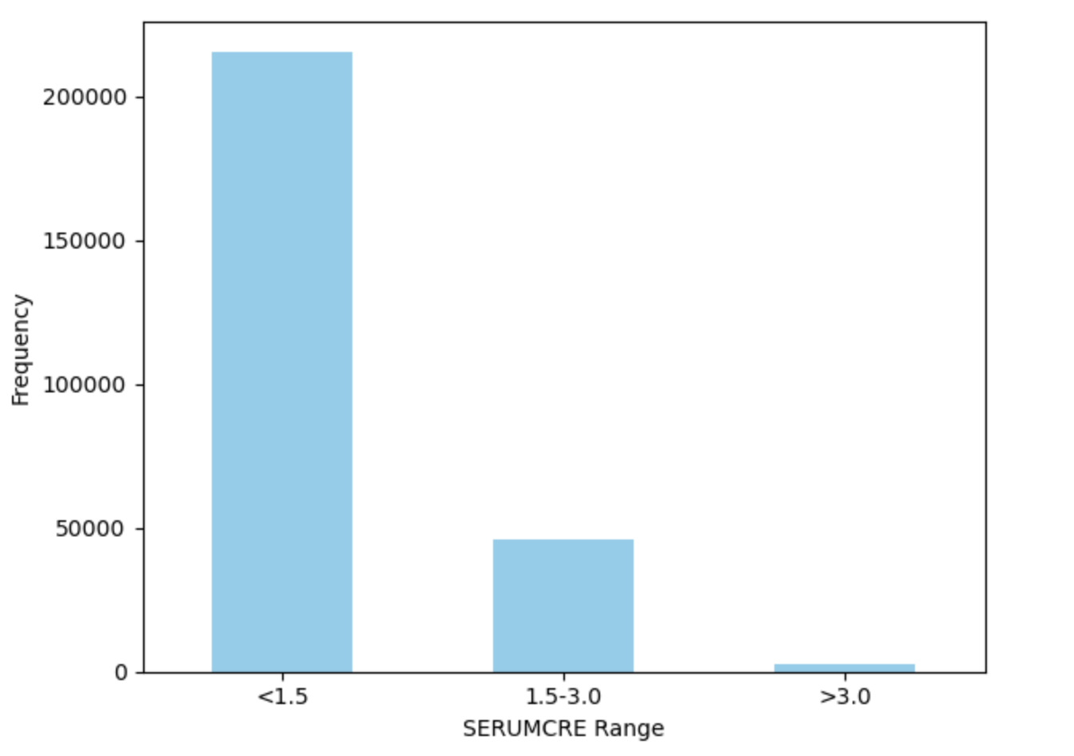
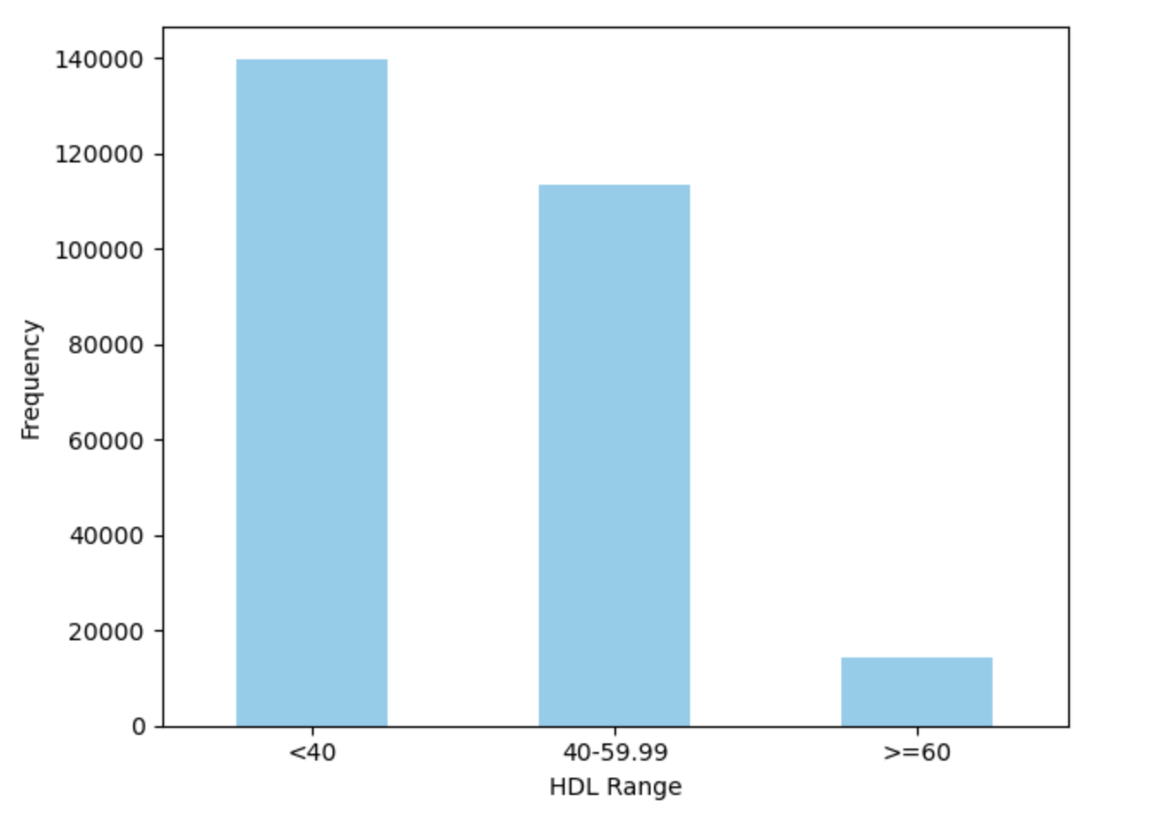
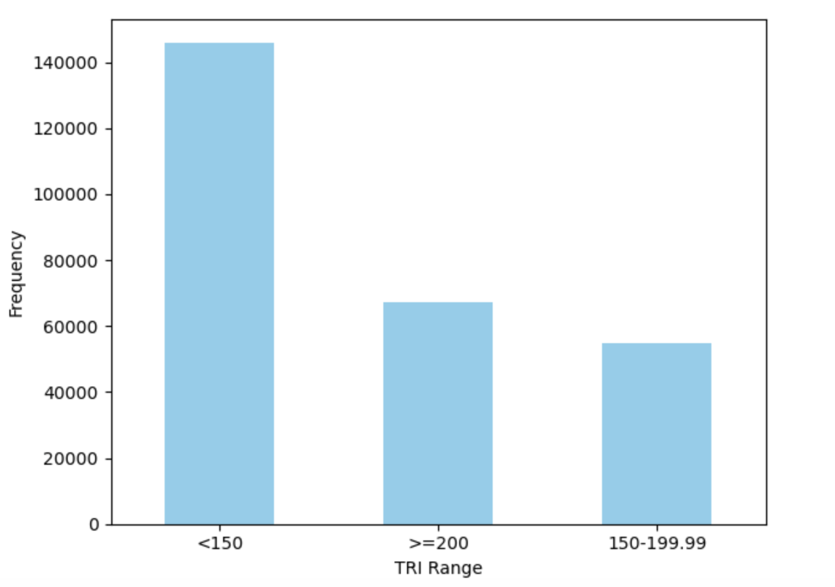
Data Preparation – Outlier Treatment (Binning)
Binning details (Continuous → Categorical)
Variables | Binning Labels
Age | 65-69, 70-74, 75-79, 80- 84, 85-89, >=90
BMI | <18.5, 18.5-24.9, 25- 39.9, 40-49.9, >=50
A1C | <8, 8-9, >9
SERUMALB | <3.5, >=3.5
SERUMCRE | <1.5, 1.5-3.0, >3.0
N_IP | 0-5, >5
N_OP | 0-5, 6-30, >30
SYSTOLIC | <120, 120-129, 130-139, 140-179, >=180
DIASTOLIC | <80, 80-89, >=90
TRI | <150, 150-199.99, >=200
LDL | <100, 100-129.99, 130- 159.99, 160-189.99, >=190
HDL | <40, 40-59.99, >=60
FRAILTY | Non-frail, Pre-frail, Mild, Moderate, Severe
Binning the data of continuous variables with outliers and converting them into categorical variables
17

Slide 18
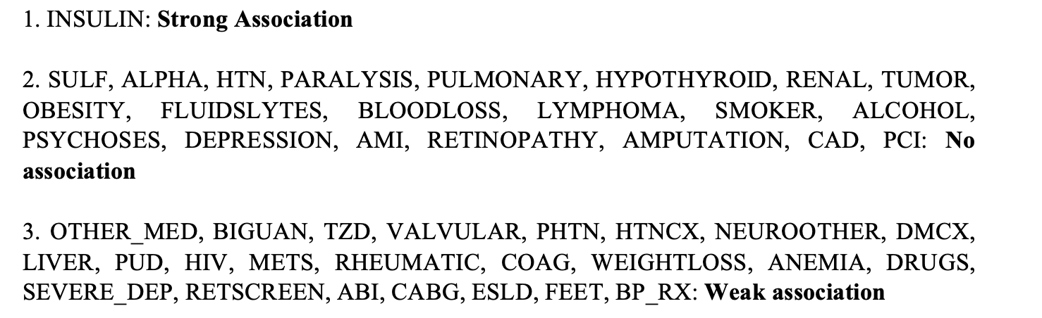
PHI Coefficient Inference

Slide 19
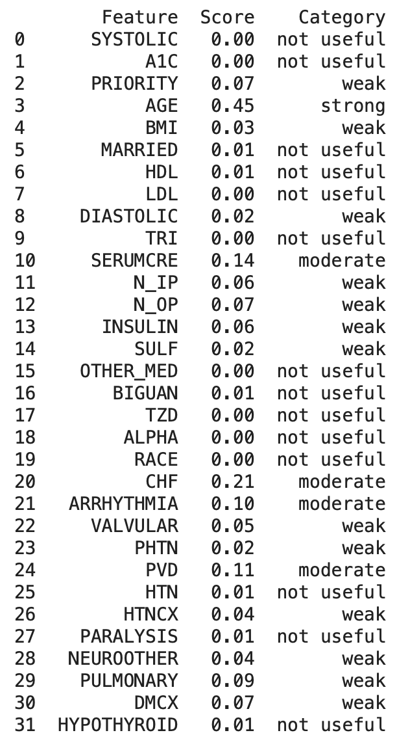
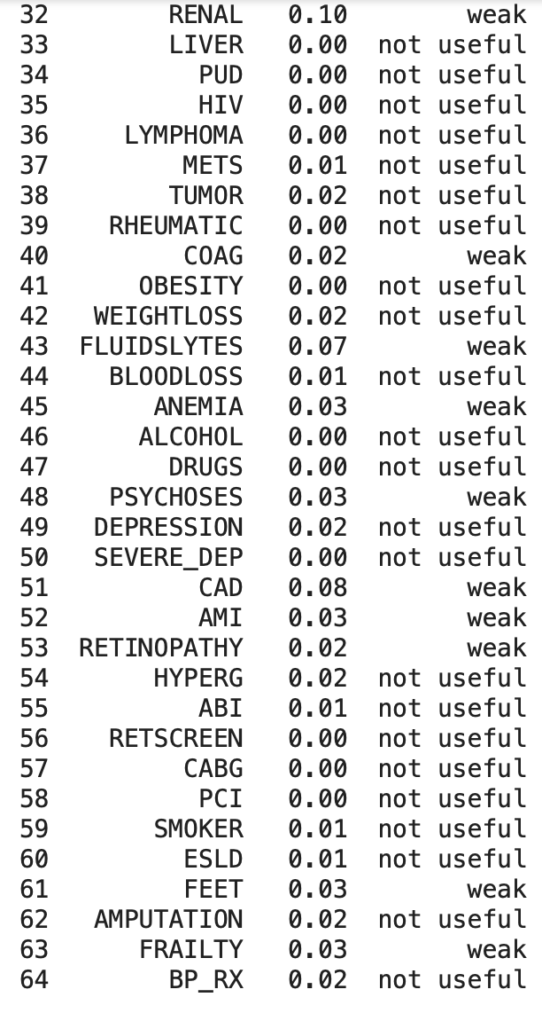
Information Value

Slide 20
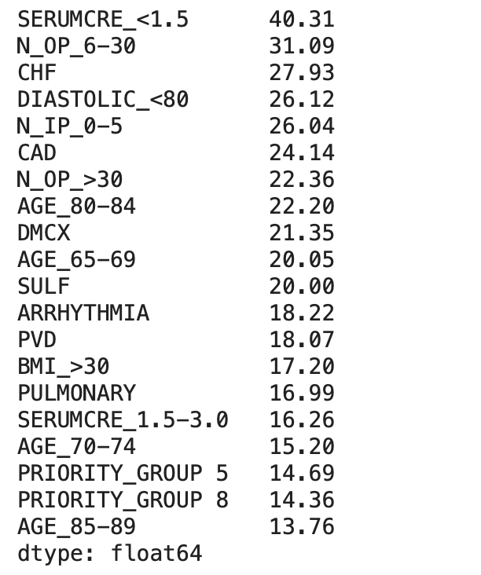
Mutual Information

